Slide 1
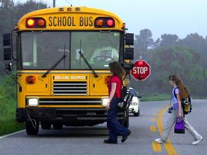


School Bus Safety – Middle SCHOOL
Notes:
KEY –
Italic text = Instruction/background information for teachers
** = Click to advance bullets on the slide. A remote clicker or wireless mouse is recommended.
NOTE TO TEACHERS – Georgia fatalities and serious injuries continue to occur at school bus stops, caused by a variety of circumstances and errors on the part of the student, the school bus driver and the passing motorist. In the 2010, 2011, 2012, 2013 and 2014 school years Georgia experienced a total of 11 student school bus stop fatalities, several serious injuries and numerous near misses when students were getting on and off the school bus. These tragic events point out the need to look at ways to reduce the possibility of similar tragedies ever happening again.
Slides 3, 5-12, 15 and 18 teach Essential Safe Student Behaviors that, when missing, have historically resulted in severe student injury or student death in Georgia. These are essential high priority safe behaviors that must be taught and fully developed in the classroom to ensure student safety. Please spend the time necessary on these slides to teach these essential behaviors. The School Bus Safety Power Point Narrative is designed to provide the points to TEACH on all slides in the program, but is inadequate if just read.
Your class will be composed of those who ride the bus to and from school and others who may ride infrequently or who ride only on field trips. This instruction is for everyone. Students not currently riding the bus to and from school may ride the bus in future years or at future schools attended. Additionally, all students will be a bus rider when on field trips where the Danger Zone training, safe riding practices and emergency evacuation training is highly relevant.
Getting on and getting off a school bus are absolutely the most dangerous activities that a student performs daily. The National Safety Council estimates that 80-85 percent of all accidents in the field of pupil transportation occur at the time students are being loaded and unloaded. In recent years, sixty percent (60%) of the pupils fatally injured in the loading and unloading zones were killed by their own bus. Recent national and Georgia statistics show the need for students to be trained on the proper procedures for loading and unloading. You can play an important role in the delivery of essential school bus safety training to our student riders.

Slide 2

School Bus Safety
This unit will teach you about:
  School bus stop safety
  School bus danger zone
  Loading & unloading
    How to cross the road
    (if required)
  Loading and unloading
  at school
  Riding the bus safely
  Emergency school bus evacuation
Notes:
In this unit we will learn behaviors that keep you safe when you are riding the school bus. The school bus safety training covers:
School bus stop safety
**The school bus danger zone
**Loading & unloading
**How to cross the road when you get on and off the bus (if required)
**Loading and unloading at school
**Riding the bus safely
**Emergency school bus evacuation (leaving the bus quickly & safely in an emergency)

Slide 3

Bus Stop Safety
Important behaviors at the bus stop:
  Arrive 5 minutes before bus is scheduled
  Go back home for help if you miss bus
    Never walk to another stop
    Never have parents drive to another stop
      Bus driver will not know
  Have all items in book
  bag before leaving home
  Wait in safe place, 12 feet
  away from traffic
  Do not cross before bus comes
Notes:
Let’s talk about safety at the school bus stop.
Get up on time and arrive at the bus stop five minutes before the bus is scheduled to come.
**Go back home and get help or phone for assistance if you miss the bus. Get someone you know to take you to school. NEVER chase after the bus, NEVER walk to another bus stop
**and tell your parents to NEVER drive you to another bus stop. Your bus driver will not be expecting you and you will be in grave danger when approaching the unsuspecting school bus driver. It is better to be late for school and be safe!
**Have all items in your book bag before you leave home so you don’t drop anything.
**And wait in a safe place, 12 feet away from traffic.
**If you have to cross the road to get on your school bus, then wait until it comes and let it use the stop arm and signals to help you cross.

Slide 4
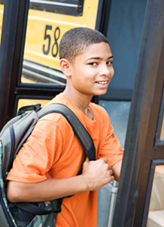
More Bus Stop Safety
Never speak to strangers
Respect property of others
Keep noise down while
waiting
Stay away from road
No horseplay, pushing or
shoving
Form a “single file” line
12 feet away from road
Use no electronics when boarding
Notes:
When at the school bus stop:
Never speak to strangers at the bus stop and never get into the car with a stranger. Tell your bus driver, your teacher or your parents if a stranger tries to talk to you or pick you up.
**Respect the property of home owners at the bus stop. You may be waiting in their yard, but don’t bother their flowers or bushes.
**And also keep the noise down since someone in the house close by may still be asleep.
**Stay away from the road. Moving cars are a danger.
**Avoid horseplay, pushing or shoving. Someone could get hurt.
**Keep electronic equipment packed away when preparing to board. Never use an electronic device or wear ear buds/headphones when boarding. You MUST be able to hear!
**Keep electronic equipment packed away when preparing to board. Never use an electronic device or wear ear buds when boarding.
Wait there before moving to the school bus. You will later learn what to do next when you start to board the bus.

Slide 5
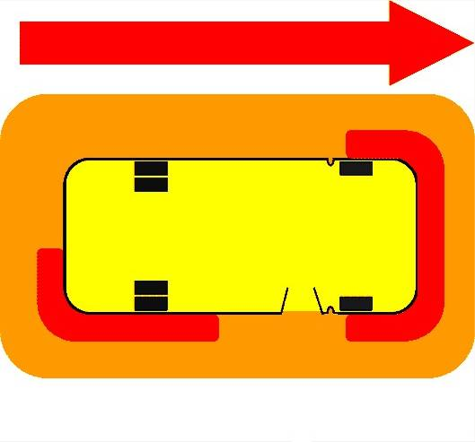
School Bus Danger Zone
Danger from Passing Cars
Danger from Passing Cars
-12 Feet-
Danger Zone
Rear
School
Bus
Front
Danger Zone
Danger Zone
Danger from Passing Cars
Most Dangerous
Most Dangerous
Danger Zone
-12 Feet-
Notes:
NOTE TO TEACHERS – The School Bus Health & Safety Curriculum document contains this image, suitable for duplication and distribution as a handout.
Please follow the clicks and narrative closely on this slide in order for the timing to work correctly.
___________________________________________________________________________
Do you know that there is an area around a school bus that is very dangerous? This is an area near the bus where the bus driver might not see you or where cars might be moving when you are getting on & off the school bus. The Danger Zone is…
**the twelve-foot area that surrounds a stopped school bus.
**Especially the most dangerous areas around both front tires, the front door and the right rear tires. Stay away from those tires.
___________________________________________________________________________
NOTE TO TEACHERS – In order to train students to understand, remember and practice the 12 foot minimum walk distance, one or more of the following instructional methods should be used:
a. Mark the 12 foot distance on the ground and have each student, in normal or giant steps, walk off the distance and count the steps. The student should be informed and repeatedly reminded of this total number of steps required for safety when waiting for and getting on and off the school bus.
b. Simulate having each student practice walking 12 feet away from the bus (for those who do not cross) or 12 feet ahead of the bus on the right shoulder of the road (for those who cross) until the student can clearly see the bus driver’s eyes.
____________________________________________________________________________
It is very important that you are always able to see the driver when outside the school bus and that you are always aware of the 12 foot danger zone.
You should NEVER return to the bus for something you left behind or dropped without getting the driver’s attention. You should leave any object and move to a point, out of the danger zone. You should then get the driver’s attention by putting your hands and arms above your head and waving. Wait for the driver to see you and give you instruction before returning to the bus or before picking anything up dropped near the bus. If you do not get the driver’s attention, you should not attempt to retrieve the item.
**Additionally, you must know that there is always the danger of passing cars that do not stop like they should
and not just passing from the rear on left side
**But from all directions on both the left
**and right side of the bus.
Everyone must understand the danger zone and be alert and focused at the school bus stop.

Slide 6



Loading from Door Side
A blowing bus horn
means danger.
Look & find safety.
12 Feet
STAY
Danger Zone
LOOK
WAIT
Notes:
NOTE TO TEACHERS – The School Bus Health & Safety Curriculum document contains this image, w/instructions, suitable for duplication and distribution as a handout.
Please follow the clicks and narrative closely on this slide in order for the timing to work correctly.
____________________________________________________________________________
Let’s talk about how to get onto your school bus in the morning. We will start with the rules for how to load if you do not cross the road.
You MUST:
**Stay on your side of the road until the bus arrives (at least 12 feet away from the edge of the road and 12 feet away from where the bus will come to a stop)
**and Wait for the bus to stop and for the door to open.
No movement should take place towards the bus until you look to be sure all traffic has stopped. The stop arm is asking the cars to stop, but they may or may not stop. If a car is moving, you should not move forward until it has stopped.
When it is OK . . . you must continue to
**Look in both directions for moving cars while walking through the danger zone, straight towards the door.
The driver should always be able to see you, and you should stay away from the front and rear bus tires and board the bus without delay.
Always use the handrail for safety and go directly to a seat.
**You also need to understand that approaching vehicles are a danger and the signal for danger is a continuous blowing of the bus horn. If the bus horn blows, you should “Look for dangerous vehicles and stay clear of the hazard”. The hazard will likely be a moving car so if you hear the bus horn, look to see where it is and get out of the way.

Slide 7





Loading from Across Road
A blowing bus horn means danger.
Look & find safety.
STAY
12 Feet
WAIT
Danger Zone
STOP
12 Feet
Danger Zone
LOOK
CROSS
Notes:
NOTE TO TEACHERS – The School Bus Health & Safety Curriculum document contains this image, w/instructions, suitable for duplication and distribution as a handout.)
Please follow the clicks and narrative closely on this slide in order for the timing to work correctly.
_______________________________________________________________________
If required to cross the road to board the bus…
You MUST:
**Stay on your side of the road until the bus comes (at least 12 feet away from the edge of the road), and
**Wait for the bus to stop and for the driver’s signal for when it is safe to cross from where you are waiting. You should
** Stop at the edge of the road and look both ways to be sure that any moving cars come to a stop. If a car is moving, you should not step into the road. When it is OK… you should then
**Look both ways for moving cars while walking straight across the road.
Cross 12 feet in front of the bus and make sure you can see the driver.
Use the handrail for safety and go directly to a seat.
Again, you must continue to look for moving cars; be careful in the danger zone; stay away from the front and rear bus tires and board the bus without delay.

Slide 8
Segment 2

Slide 9


Unloading to Door Side
A blowing bus horn means danger.
Look & find safety.
12 Feet
Danger Zone
LOOK
Notes:
When you are riding the bus home it is important to remain seated until the bus comes to a complete stop.
Put away any electronic equipment before standing to exit the bus. Never use an electronic device or wear ear buds/headphones until you are safely 12 feet off the roadway.
Walk to the front of the bus in an orderly manner and wait in the aisle until the driver tells you it is OK to begin to exit. The driver is waiting for all cars to stop before letting you off the bus. Moving cars are a danger.
Use the hand rail when exiting the bus so you do not fall down.
You should:
**Look for moving cars in all directions, especially to your right, before stepping off the bus.
We know that approaching cars may not stop, so if you see a car moving, you MUST wait to be sure it stops.

Slide 10
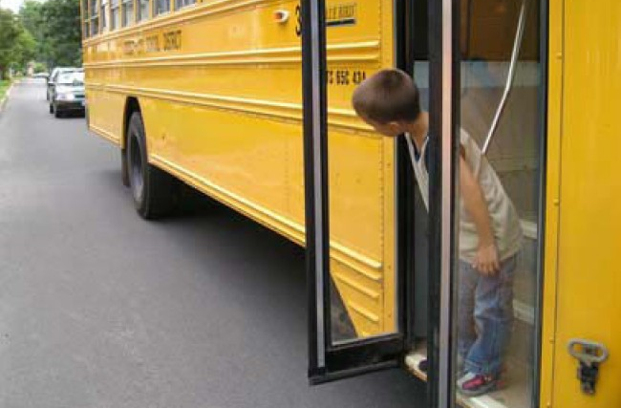
Student Responsibility – Look Before Exiting
Notes:
Even this young student understands the importance of checking to make sure no vehicle is passing on the right side of the bus. They are being sure that no car is moving before they step off the bus.

Slide 11

Unloading to Door Side
A blowing bus horn means danger.
Look & find safety.
12 Feet
Danger Zone
LOOK
LOOK
WALK
Notes:
NOTE TO TEACHERS – The School Bus Health & Safety Curriculum document contains this image, w/instructions, suitable for duplication and distribution as a handout.
Please follow the clicks and narrative closely on this slide in order for the timing to work correctly.
_______________________________________________________________________
If you do not cross the road when you get off the bus and there are no moving cars and you have stepped off the bus…
You MUST next:
**Look for cars in both directions as you . . .
Walk straight away from the bus, in full view of the driver. You should keep walking until you are out of the danger zone, 12 feet away from the bus.
Never get mail from a roadside mailbox until after the bus leaves. You need to get away from road where cars might not stop and away from the bus before it starts to move.
**Remember, if the bus driver sees an approaching danger with either their direct vision or with their mirrors, they will use their horn to signal danger.

Slide 12

Unloading to Across the Road
A blowing bus horn means danger.
Look & find safety.
Danger Zone
12 Feet
LOOK
12 Feet
Danger Zone
LOOK
STOP & WAIT
WALK
STOP & WAIT
Notes:
NOTE TO TEACHERS – The School Bus Health & Safety Curriculum document contains this image, w/instructions, suitable for duplication and distribution as a handout.
Please follow the clicks and narrative closely on this slide in order for the timing to work correctly.
____________________________________________________________________________
Remember that when riding the bus home, remain seated until the bus comes to a complete stop.
Leave your seat in an orderly manner and wait in the aisle for the driver to tell you it is OK to begin to leave the bus. The driver will wait for all cars to stop before letting you off the bus.
**Always use the hand rail when exiting the bus.
If you have to cross the road when you get off the school bus…
You MUST:
**Once again LOOK for cars in all directions before exiting.
When it’s OK. . . You should
**WALK straight away from the right front of the bus, in the driver’s full view. You must exercise caution in the danger zone.
When you get past the end of the bus crossing gate you must
**STOP and face the center of the road, look directly at the driver and WAIT for the signal that it is safe to cross. Then
**look for moving cars as you walk to the center of the road.
**STOP there and WAIT again for the driver’s signal that it is safe to finish crossing.
Then continue to
**LOOK for cars to your left and right while walking promptly across & exiting 12 feet off the road.
NEVER stop to get mail from the mailbox. If a car is coming and loses control, it might run off the road.
NEVER cross behind the bus. Cross in front where it is safe and everyone can see you.

Slide 13

Unloading at School
Important behaviors when unloading at school:
  Make sure no items get caught in handrail
  or door
  Exit danger zone
  & get bus driver’s
  attention
    Something left
    behind on bus
    Something dropped
    near bus
Notes:
Anytime you are unloading, but especially when unloading at school…
Make sure book bag straps, purses, clothing drawstrings, etc. do not get caught on the handrail or in the door. If this happens and your bus driver shuts the door and begins to move the bus it could be dangerous.
**When you unload at school, if something is left on the bus or dropped near the bus, exit the danger zone and get the driver’s attention before you return to the bus or attempt to pick up a dropped item.
____________________________________________________________________
NOTE TO TEACHERS – Have a student to demonstrate what they should do if they drop something or leave something on the bus. Here is what they should do:
They should leave any object and move to a point, out of the danger zone. They should then get the driver’s attention by putting their hands and arms above their head and waving. They should wait for the driver to see them and give them instruction before returning to the bus or before picking anything up dropped near the bus. If they do not get the driver’s attention, they should not attempt to retrieve the item.

Slide 14
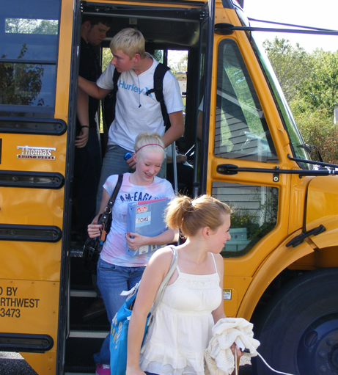
More Unloading at School (1)
Remain seated until bus is stopped and door is opened
Do not push or shove, but wait your turn to get off
Have all belongings
inside book bag
Use handrail for safety
Walk (don’t run)
straight towards school
Stay away from bus, in full view of driver
Notes:
When your bus arrives at the school in the morning:
Remain seated until the bus is stopped and door is opened. If you stand up while the bus is moving, you might fall.
**Do not push or shove, but wait your turn to get off the bus. Most bus drivers will want you to leave by letting seats take turns, going from front to back, side to side.
**Have everything inside your book bag. This reduces the possibility of dropping something near the bus which creates an unsafe situation if you try to pick it up and the bus driver does not see you.
**Use the handrail for safety. A fall down the steps could hurt you.
**Walk (don’t run) straight towards the school,
**away from the bus, so your driver can see you.

Slide 15

More Unloading at School (2)
Keep walking until out of danger zone, 12 feet away from bus
Never run between parked cars and buses
Walk directly
inside school
Do not wait for
friends
Notes:
When you get off the bus at school . . .
Keep walking until you get out of the danger zone, 12 feet away from the bus. When the bus starts to move, you want to be well away from the danger zone.
**Never run between parked cars and buses. Someone might not see you.
**Walk directly inside the school.
**Do not wait for friends. You can see them when you get inside.

Slide 16

Loading at School
Important behaviors when loading at school:
  Have all belongings inside book bag before
  leaving classroom
    Dropped items are
    a danger
  Never chase after a
  moving bus
    Better to miss bus
    and be safe!
Notes:
When school ends in the afternoon . . .
Have all belongings inside your book bag before leaving the classroom. This reduces the possibility of dropping something near the bus which creates an unsafe situation where the driver might not see you and begin to move the bus.
**If you drop or forget something on the bus, remember that if you don’t see the driver, the driver doesn’t see you. Wait until you can see the driver, then put your hands above your head and wave them to get the driver’s attention. Do not try to get the item if you do not get the attention of the bus driver. The item can be replaced. YOU CANNOT BE REPLACED!
**Never chase after a moving bus. Once the buses start moving – you should stop moving. It is better to miss the bus and be safe!

Slide 17
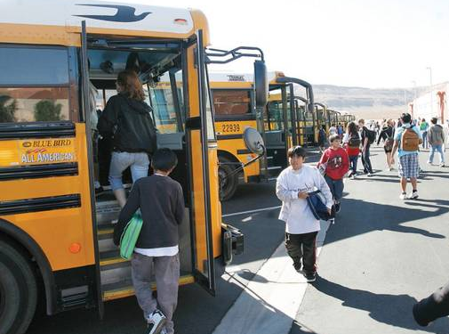
More Loading at School (1)
Walk slowly towards bus. Never run.
Walk straight towards bus door
  Be sure bus driver can see you
Stay away from front and rear bus tires and board bus promptly
Load in an orderly
manner
If you get on wrong
bus by mistake, tell
bus driver
Notes:
As you are going to get on the bus . . .
Walk slowly towards your bus. Never run.
**Walk straight towards the bus door and be sure your driver can see you.
**Stay away from the front and rear bus tires and board the bus without delay.
**Load in an orderly manner.
**Make sure it is the right bus. If you get on the wrong bus by mistake, tell the driver. We do not want you to get lost.

Slide 18

More Loading at School (2)
Use handrail for safety
Go directly to seat
Never place head, arms or any object out of bus window
Notes:
When getting on the bus at school . . .
Use the handrail for safety.
**Go directly to your seat so that others can be seated.
**Do not do what these students are doing. Never place your head, arms or any object out of the window. The bus could start to move and drive close to something and you could get hit.

Slide 19
Segment 3

Slide 20

Riding Safely
Important behaviors when riding the bus
  Sit the safe way:
    Facing forward
    Back against seat back
    Bottom against seat
    bottom
    Fully within the seat
    space
  Remain absolutely quiet at railroad grade crossings
Notes:
There are some important things you need to do when you are riding the bus. The 2 most important are . . .
Sit the safe way, facing forward with your back against the back of the seat and your bottom against the bottom of the seat. Be sure your bottom is not hanging off the seat. If there is not room for you in a seat, then sit somewhere else where there is room.
**You must remain absolutely quiet at railroad grade crossings. This is a critical moment as bus drivers must be able to hear an approaching train.

Slide 21

More Riding Safely (1)
Follow bus driver’s directions the 1st time
Always go directly to seat
When on the bus, remain
seated
Always sit forwards with
your back against the seat
Tell bus driver if someone
is picking on you
Keep aisles and exits clears at all times
Notes:
NOTE TO TEACHERS – The school bus driver has authority over, and responsibility for, students while on the bus. It is the student’s responsibility to follow the rules and follow the direction of their school bus driver. Proper student behavior is important because any driver distraction is potentially hazardous to student safety, the safety of the driver and the safety of other road users.
Students should be aware that they are responsible for their actions and behavior and that school bus transportation can be denied if they do not conduct themselves properly.
_______________________________________________________________________
Anytime you are riding the school bus you should:
Follow directions of the school bus driver the first time given. They are like your teacher and you should listen and do what they say.
**Go directly to an available or assigned seat when entering the bus so everyone can get seated and the bus can move. If you are standing up when the bus moves you might fall.
**Remain seated, facing forward with your back against the seat. This keeps you safe if the bus driver has to steer or stop quickly.
**Tell your bus driver if someone is picking on you or making you feel uncomfortable. They can help you to make it stop.
**Hold your books and other things in your lap so the bus aisles and exits are clear. We do not want anyone to trip and fall on anything.

Slide 22

More Riding Safely (2)
Respect others and their property
Be quiet enough to not distract driver
Don’t eat, drink, or chew gum on bus
Don’t throw any objects
Don’t stick any body part
out of bus window
Don’t bring or use tobacco,
drugs, or weapons on bus
Notes:
When riding the bus you should:
Respect the rights and safety of others. Never bother things that belong to someone else.
**Talk in a quiet voice. We want the bus driver to not be distracted so they can drive safely.
**Do not chew gum, eat or drink on the bus. You could get choked, or you could drop or spill something which would make the bus dirty or cause someone to slip and fall.
**Never throw anything on the bus. Someone could get hurt or your bus driver could be distracted and have a wreck.
**Never stick your head, arms or hands out of the bus window.
**Never bring tobacco, drugs, knives or weapons on the school bus.

Slide 23

More Riding Safely (3)
Don’t bring animals or glass objects on bus
Don’t use obscene gestures and/or language
Don’t use cell phones on bus or when exiting
Never use electronic device or wear headphones/ear buds when exiting
Only get off of bus at your stop
Keep bus clean
Notes:
There are more rules to follow when you are on the school bus. You should:
Never bring animals or glass objects onto the bus. Animals could get loose. You could drop something glass, and if it breaks then someone could get hurt. If something is too big to hold in your lap and you need to take it to school, then get your parent to drive you to school that day.
**Never use obscene language or gestures. Be nice to everyone and they will be nice to you.
**Never operate cell phones while on the bus or when exiting the bus. If you have a cell phone keep it in your pocket, book bag or purse.
**Also, never use an electronic device or wear ear buds or headphones when exiting the bus. You MUST be able to hear!
**Never leave or board the bus at locations other than your assigned stop. Follow local school system procedures to obtain signed permission for a change of stop location.
**Help keep the bus clean. A clean bus is safer and more fun to ride than a dirty bus.

Slide 24
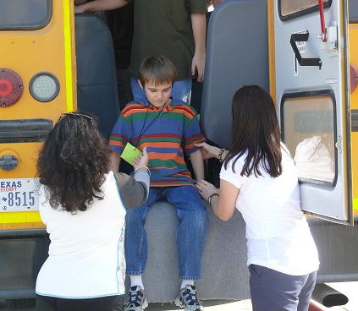
Emergency Evacuation
When might you evacuate?
  Accident
  Fire
  Emergency where you need to leave bus quickly
There are 3 ways to
evacuate the bus
  Front door
  Rear door
  Front and rear door
Notes:
NOTE TO TEACHERS – School bus evacuation drills will be conducted by your Pupil Transportation Department during the school year. You are in a controlled learning environment and can help to lay the groundwork for those drills and prepare your students for a possible real emergency bus evacuation.
________________________________________________________________________
We are now going to talk about what you might need to do if something goes wrong on your school bus and you have to evacuate – leave the bus quickly & safely in an emergency. Your school bus driver will do an emergency evacuation drill with you a couple of times this year.
**Evacuation of your school bus may be required in case of some bus accidents, fire or an emergency where it was important for you to leave the bus quickly.
**There are three ways to evacuate the bus:
1. Front door – If there is an emergency and there is no danger in using the front door, you will do a front door evacuation. In a front door evacuation the bus driver will choose one leader to lead you to a safe place 100 feet (3 bus lengths) away from the bus. The driver will unload students by letting seats take turns, going from front to back, side to side.
**2. Rear emergency door – If there is an emergency and the front door cannot be used, you will do a rear door evacuation (all rear-engine buses are equipped with a side emergency exit door in lieu of a rear emergency door). In a rear door evacuation, the driver will choose one leader to lead you to a safe place 100 feet (3 bus lengths) away from the bus. They will also choose two helpers to assist you as you go out the back door using the “Sit & Scoot” method. The driver will unload students by letting seats take turns, going from side to side. The emergency door is to be used only at the driver’s or student helper’s direction.
Sit & Scoot – (Reference picture on slide) When you get to the emergency door you will NOT jump out of the door. You WILL sit down so your bottom is on the floor and your feet are hanging out of the door. Student helpers will assist you as you scoot out of the door and land gently on both feet.
**3. Both front door and rear emergency door – If you need to evacuate the bus as fast as possible, you will use both the front and rear doors where the front half of the bus exits through the front door and the rear half exits through the rear emergency door. Leaders will take you to a safe place 100 feet (3 bus lengths) away from the bus.

Slide 25
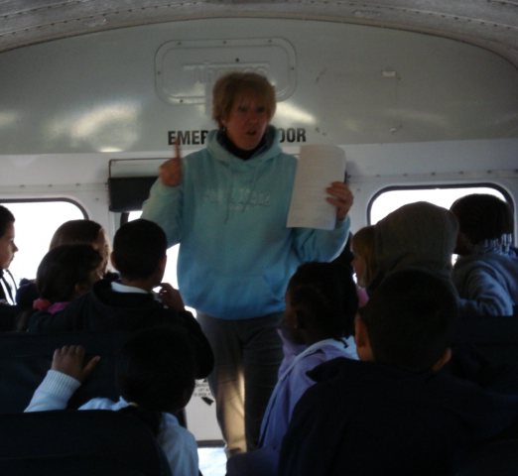
More Emergency Evacuation (1)
Buses also have
  Roof hatches
  Emergency windows
In all types of evacuation:
  Listen to bus driver’s
  instructions
  Remain calm
  Remain quiet
  Stay seated until it is your turn to leave
  Unload letting seats take turns
Notes:
Buses also have roof hatches on top of the bus and emergency windows on the sides that open big enough for you to get through. These can be used in an evacuation if other exits are blocked or if the bus turns over.
**In all types of evacuation it is important that you:
Listen to the driver’s instructions.
Remain calm and remain quiet so you can hear the driver’s instructions.
**Stay seated until it is your turn to leave the bus. You will unload letting seats take turns, going from side to side.

Slide 26
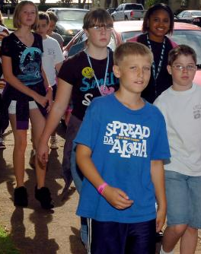
More Emergency Evacuation (2)
In all types of evacuation (Continued):
  Leave books, lunch boxes, and other belongings on bus
  Walk as you leave the bus. Do not run.
  Go 100 feet (3 bus lengths)
  away from bus
  Remain in an orderly group
  Wait for further
  instruction from bus
  driver or student helper
Notes:
When evacuating the bus it is important to leave books, lunch boxes, and other personal belongings on the bus so you can leave quickly. Those items can be replaced. YOU CANNOT BE REPLACED!
**Walk as you leave the bus. Do not run.
Go 100 feet (3 bus lengths) away from the bus.
**Remain in an orderly group and wait for further instruction from your driver or a student helper.

Slide 27
Were You Paying Attention?
How far should you wait off the road at your school bus stop?
  12 feet
If you need to cross the road to get on the bus, where should you be standing when the driver gives the signal to cross?
  Still standing 12 feet away from road
For students crossing to board in AM, where must you stop and look?
  At the edge of the road
Notes:
Were you paying attention?
Q - How far should you wait off the road at your school bus stop?
**A - 12 feet
**Q - If you need to cross the road to get on the bus, where should you be standing when the driver gives the signal to cross?
**A - Still standing 12 feet away from the road
**Q - For students crossing to board in the morning, where must you stop and look?
**A - At the edge of the road

Slide 28
Were You Paying Attention?
When unloading in PM, what must you do before stepping off the bus?
        Look for moving cars on the right side
If you need to cross in the PM, where do you stop & wait for the driver to signal?
  End of crossing gate
  Center of road
Notes:
Q - When unloading in the afternoon, what must you do before stepping off the bus?
**A - Look for moving cars on the right side
**Q - If you need to cross in the afternoon, where do you stop & wait for the driver to signal that it is OK to continue?
**A – At the end of the crossing gate and again at the center of the road

Slide 29
Were You Paying Attention?
When you exit in the PM, how far should
you go off the road before stopping?
  12 feet
Why is it important for items to be in book
bag before boarding in AM or PM ?
  Dropped items are a danger
What should a you do if you drop something near the bus or leave something on the bus?
  Get out of the danger zone
  Get driver’s attention & wait for instruction
Notes:
Q - When you get off the bus in the afternoon, how far should you go off the road before stopping?
**A - 12 feet
**Q - Why is it important for all items to be in a book bag before getting on the bus at the bus stop in the morning or getting on at the school in the afternoon?
**A - Dropped items are a danger if you try to pick them up and the bus driver does not see you.
**Q - What should you do if you drop something near the bus or leave something on the bus?
**A - Get out of the danger zone
Get the driver’s attention
And wait for instruction from the driver

Slide 30
Acknowledgements
  The Georgia Department of Education
    Pupil Transportation Division
    Curriculum and Instruction Division
  Georgia’s School Bus Drivers for providing
  safe, efficient and reliable transportation
  for Georgia’s students

