Slide 1
The Leader in Me

Slide 2

The Seven Habits of
Highly Effective Kids by Sean Covey

Slide 3
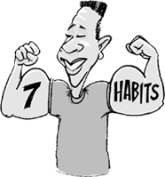
What is a Habit?
A habit is
something you do
over and over
again, like how
you write, fold
your arms, or
brush your teeth.

Slide 4

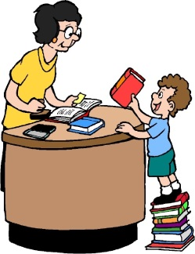
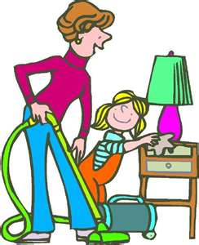
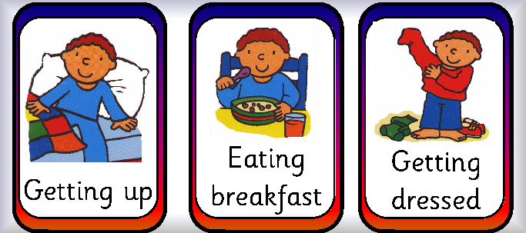
Habit # 1
“Be Proactive”
This is the habit of
Personal Responsibility
You are in charge of you.

Slide 5
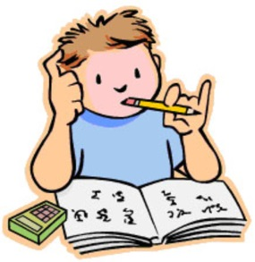


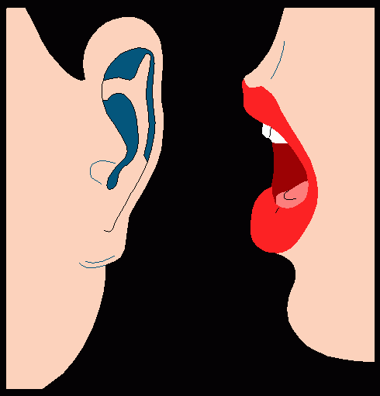
Personal Responsibility
You are responsible for yourself:
What you choose to do
What you choose not to do
What you say
What you don’t say

Slide 6
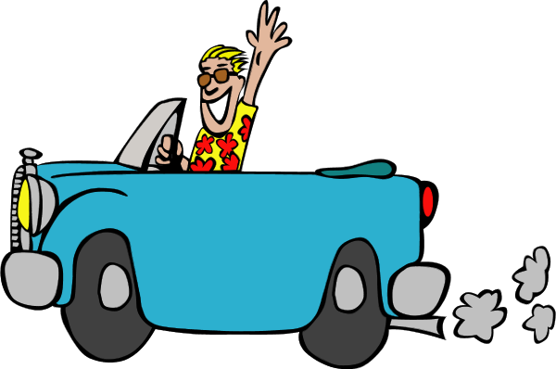

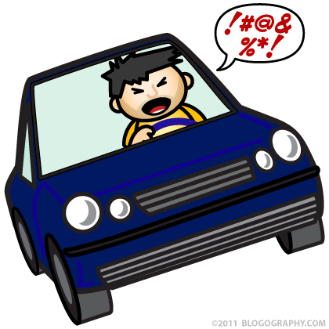

Proactive vs Reactive

Slide 7
Common Practices
React based on moods, feelings and circumstances
Blame others
Waste time and energy on things that you cannot control
Result - You lose your control of influence. Others do not trust you and feel like they cannot depend on you.

Slide 8
Effective Practices
Pause….and think about your choices before just reacting
Focus on the things within your control
Result - You are highly trusted by others. Your circle of influence grows.

Slide 9


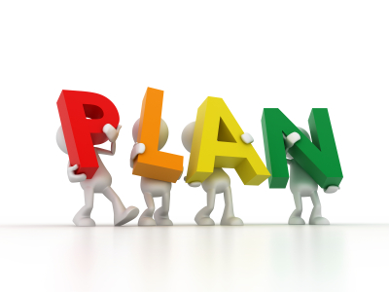

Habit # 2
“Begin With the End in Mind”
This is the habit of setting goals and making plans to reach them.
It is the difference between just “letting life happen to you” and having “control over where you go in life.”

Slide 10
Common Practices
Get started without a clear idea of what you want to achieve
Let others’ agendas and circumstances define how you live your life.
Result – You achieve less and you struggle to find your purpose
in life.

Slide 11
Highly Effective Practices
Define your purpose in life and have a vision of how to fulfill that purpose
Define outcomes before you act.
Make a plan
Result – You will achieve more and you will
continue to grow and develop.

Slide 12
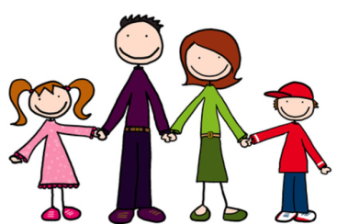
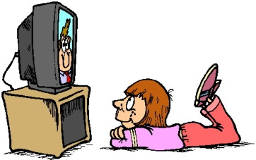


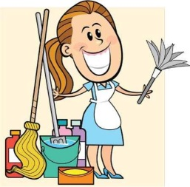

Habit # 3
“Put First Things First”
This is the habit of Personal Management

Slide 13

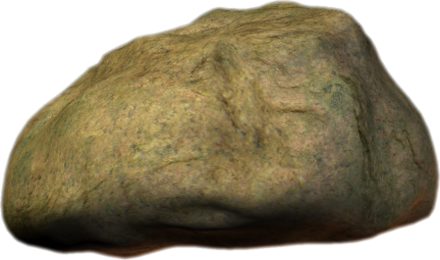
Big Rocks vs Little Rocks
Those things that are most urgent and important
Those things that can wait until later.

Slide 14
Common Practices
* Spend most of your time on managing crises and other people’s agendas.
Try to do it all
Give in to the pressures of the moment.
Result – Fewer things get done and those things that do get done are usually done ineffectively.

Slide 15
Highly Effective Practices
Focus on your highest priorities
Eliminate the unimportant
Plan every week
Stay true in the moment of choice
Result – The important things in your life get
done well.

Slide 16
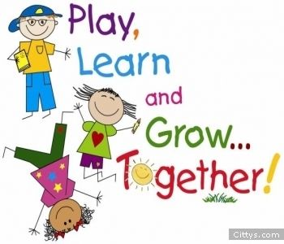
Habit # 4
“Think Win-Win”
This is the Habit of Mutual Benefit

Slide 17
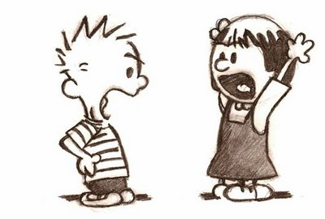
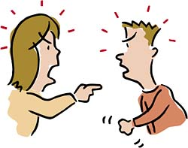
Four Ways of Thinking
Imagine that your children are fighting over the TV remote.
Win-Lose
I get the remote and you get nothing
We don’t have enough for both of us.
Lose-Win
You get the remote and I get nothing
If you win, I am a loser
Win-Win
You and I decide together to turn off the TV and play cards
It’s not you or me, it’s about both of us
Lose-Lose
We argue and I throw the remote against the wall.
If I’m going down, you’re going down with me.

Slide 18
Common Practices
  Compare, compete and feel threatened by other people’s success.
  Be insensitive to the needs and wants of others, or relinquish your needs and wants to the demands of others
  Consider only your own needs
  Expect to either win or lose
Result – Everything is a competition. Lots of conflict is happening. No one feels respected.

Slide 19
Highly Effective Practices
Have an Abundance Mentality
Balance courage and consideration
Consider other people’s wins as well as your own
Create Win-Win Agreements
Result – People feel respected. More things get done because everyone is working as a team.

Slide 20

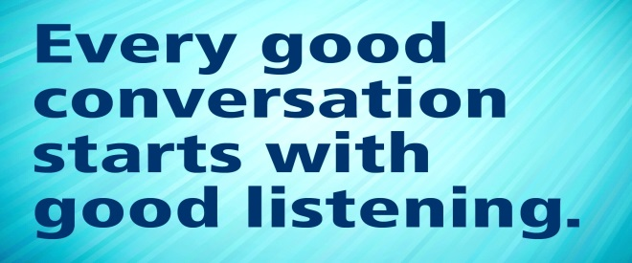
Habit # 5
“Seek First to Understand, Then to Be Understood
This is The Habit of Empathic Communication

Slide 21

Empathic Listening is listening with the sole
intent to understand another person. It
is listening with understanding and
and respect.
Stop talking and listen empathically when:
* emotion is high
* You must get to the heart of the issue
* You feel that you don’t understand
* The other person doesn’t feel understood
Slow down:
* Watch and be ready to listen empathically
Go forward and seek to be understood when:
* The issue is clear and mutually understood
* The conversation is casual and unemotional
* You’re asked to give counsel or advice

Slide 22
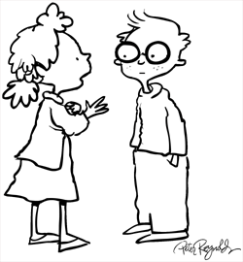
“When you really listen to another person from their point of view, and reflect back to them that understanding, it’s like giving them emotional oxygen.” - Stephen R. Covey
Important steps to empathic listening:
* Listen to what the speaker is saying
* Give an empathic response
* Ask a clarifying question

Slide 23
Examples of Empathic Listening
Child: Mary is being really mean to me. I thought she was my friend!
Parent Response: It sounds like you are really upset with Mary.
Child: I am.
Parent Response: Can you tell me more?
Child: Mrs. Smith hates me. I can’t do anything right.
Parent: You sound very frustrated.
Child: I hate school and I never want to go back there.
Parent: When you say “Mrs. Smith hates me,” what is it that makes you think that is true?

Slide 24
Common Practices
Listen with the intent to reply.
( Rather than listening to what is being said, you are thinking about
what you are going to say)
Confront and offend, or don’t speak up at all.
Result – No one feels listened to and the
conversation stops. Anger and hurt
feelings are present in both people.

Slide 25
Highly Effective Practices
Practice Empathic Listening
Respectfully seek to be understood.
Seeking to be understood is the second half of effective
communication. Once you are confident the other person
feels completely understood, you may share your point
of view with respect and openness.
Examples: “I can see what you mean. I have a different point of view I’d like
to share.”
“ Thank you for sharing your thoughts. Would you be willing to
hear mine?”
Result – People open up to each other and the conversation continues.

Slide 26
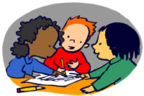
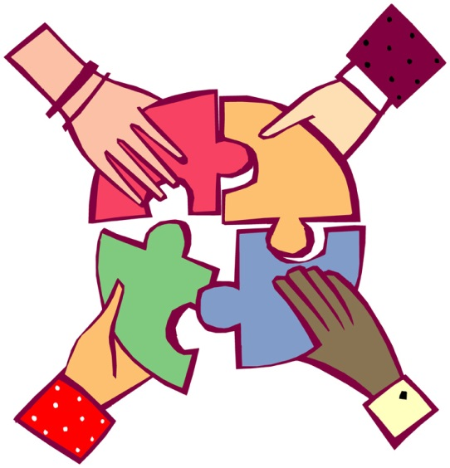
Habit #6
“Synergize”
This is the habit of Creative Cooperation
Based on the principles of
Creativity, Cooperation, Diversity, and Humility.

Slide 27
Synergy depends on a willingness to seek a
3rd Alternative. It also requires humility and the ability to keep your ego in check.
Synergy is NOT the same thing as compromising. It is the ability to take 2 ideas and come up with an even better 3rd idea.

Slide 28
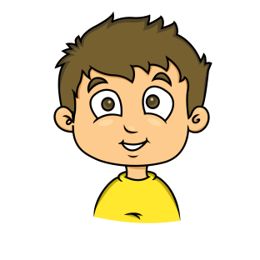
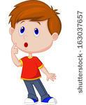

What does Synergy look like?
My friend Jack is coming over to play. I love to build things so I am going to ask him to play Legos.
I am so excited that it snowed last night. I hope Ryan wants to go outside and build a snowman.
We are going to go outside to play. Jack is going to build a snowman and Ryan is going to build a city around it using his legos.

Slide 29
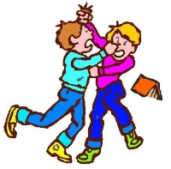
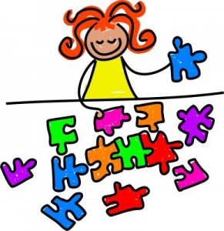
Common Practices
Reject or tolerate differences
Settle for conflict or compromise
Result – Someone wins and someone loses.

Slide 30
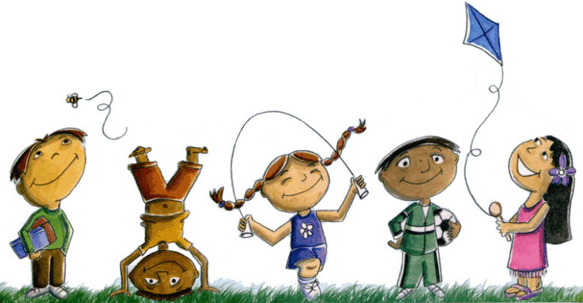
Highly Effective Practices
Value Differences
Seek 3rd Alternative
Result – Everyone wins and feels
included and important

Slide 31
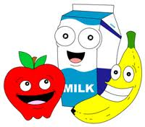


Habit # 7
“Sharpen the Saw”
The Habit of Daily Self-Renewal

Slide 32
The Four Dimensions of Renewal
Exercise, nutrition, rest, stress management
BODY
Managing key relationships, doing for others
HEART
Service, values, inspirational, nature
SPIRIT
Reading, writing, learning, study
MIND
Each aspect requires continuous renewal to remain in balance.
In the same way, if each is nourished, all four will flourish.
If one is neglected, it will negatively impact the other three.

Slide 33
Common Practices
Rarely invest in yourself
I’m too busy today to take time for myself
Result – You are out of balance. You are exhausted.

Slide 34
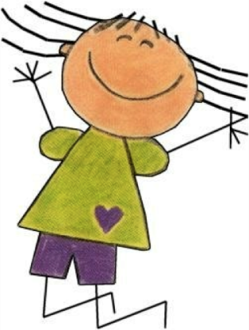
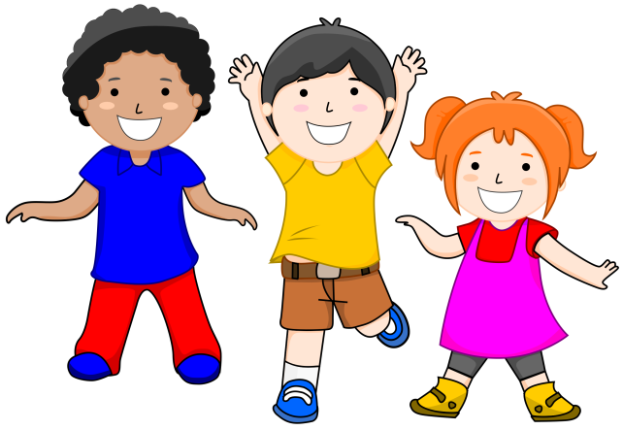
Highly Effective Practices
* Achieving the Daily, Private Victory
The Daily Private Victory is a practice. It’s a pattern, routine, or regimen that you follow every day to renew yourself in the four dimensions of your life. The Daily Private Victory allows you to master the Public Victory. Achieving the Daily Private Victory will affect every decision and every relationship in a positive way.
Result – You feel great and life goes a lot smoother.

