Slide 1
When, which one, why?
How do I decide which test to take?
When should I test?
How many times should I plan to take the tests?
senior meetings start in August of senior year – important to take the tests this year so you have a score and to see if you need to improve the score for the colleges you are trying to attend.

Slide 2
SAT vs ACT
4 multiple choice tests(English, Math, Reading, Science)
Composite score/36
No penalty for guessing
Students should answer all questions
Align w/ high school curriculum
Writing Test optional
www.act.org
Evidence based reading and writing
Math
1600 Score
No Penalty for guessing
www.sat.org
Important to include SS#
School Code WHS 111279
Both have testing securities:
Upload photo
No ticket, No ID, No admission!

Slide 3
Practice…practice…practice
Khan academy
Collegeboard.org(sat.org)
Testpreppreview.com
Princetonreview.com
Testpreppractice.net
Varsitytutors.com

Slide 4
Test Dates & Registration Deadlines
SAT ACT
*December 4th (Nov. 4th) *December 11th (Nov. 5th)
*March 12th (Feb. 11th) *February 12th (Jan. 7th)
May 7th (April 11th) april 2nd (Feb. 25th)
June 4th (May 5th) june 11th (May 6th)
July 16th ( june 17th)
* These are the last test options for dual enrollment for the 22-23 school year. Required for Clayton state university.

Slide 5
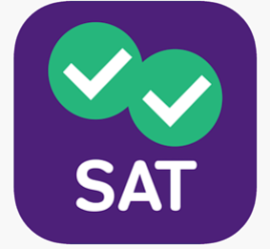
Download apps….

